Slide 1

R-ticulating Data
A Data Visualization Lesson and Demo
Jeremy R. Groves, Ph.D, ACUE
Tech Tacos – November 10, 2026

Slide 2
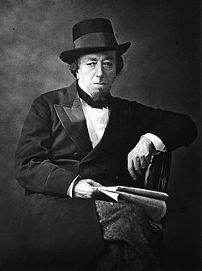
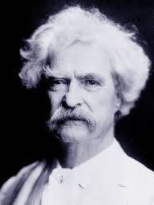
Lies, Damn Lies, and Statistics
Data visualization is an important skill because it allow us to tell a story in a simple and quick format.
I call this a skill, however, because it can be easily used to skew a story.
There are three kinds of lies: lies, damn lies, and statistics.
Benjamin Disraeli
Prime Minister: UK
1868

Slide 3
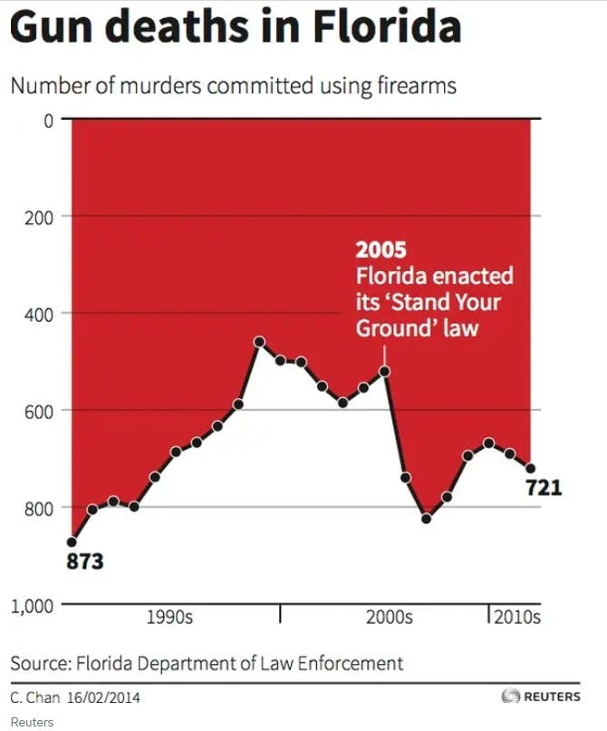
Bloody Bad Graphs
This is an example of a graph posted in response to the Florida “Stand Your Ground” law.
While the creator was likely trying to be artistic, notice how a quick view tells a very different story than what is really going on.

Slide 4
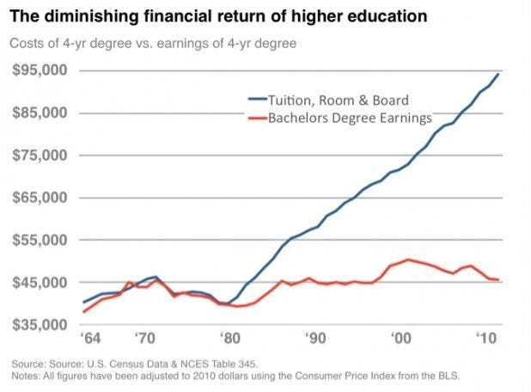
Don’t Look Behind the Curtain
Here is another fun one. Should you get a college degree?
Clearly the answer here appears to be a resounding NO!
What is so misleading about this graph?
  No reference to no college degree.
  College costs for a 4-yr degree is a “one shot”, earnings is annual.

Slide 5
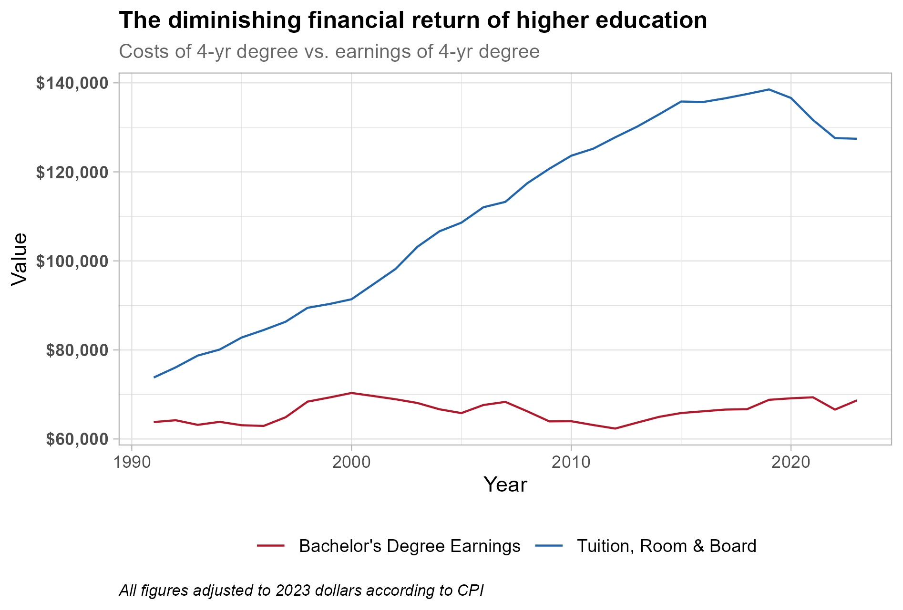
Replicate Disaster
https://miro.medium.com/v2/resize:fit:927/1*eCziTupD-0SPMFEIydMLSA.jpeg

Slide 6
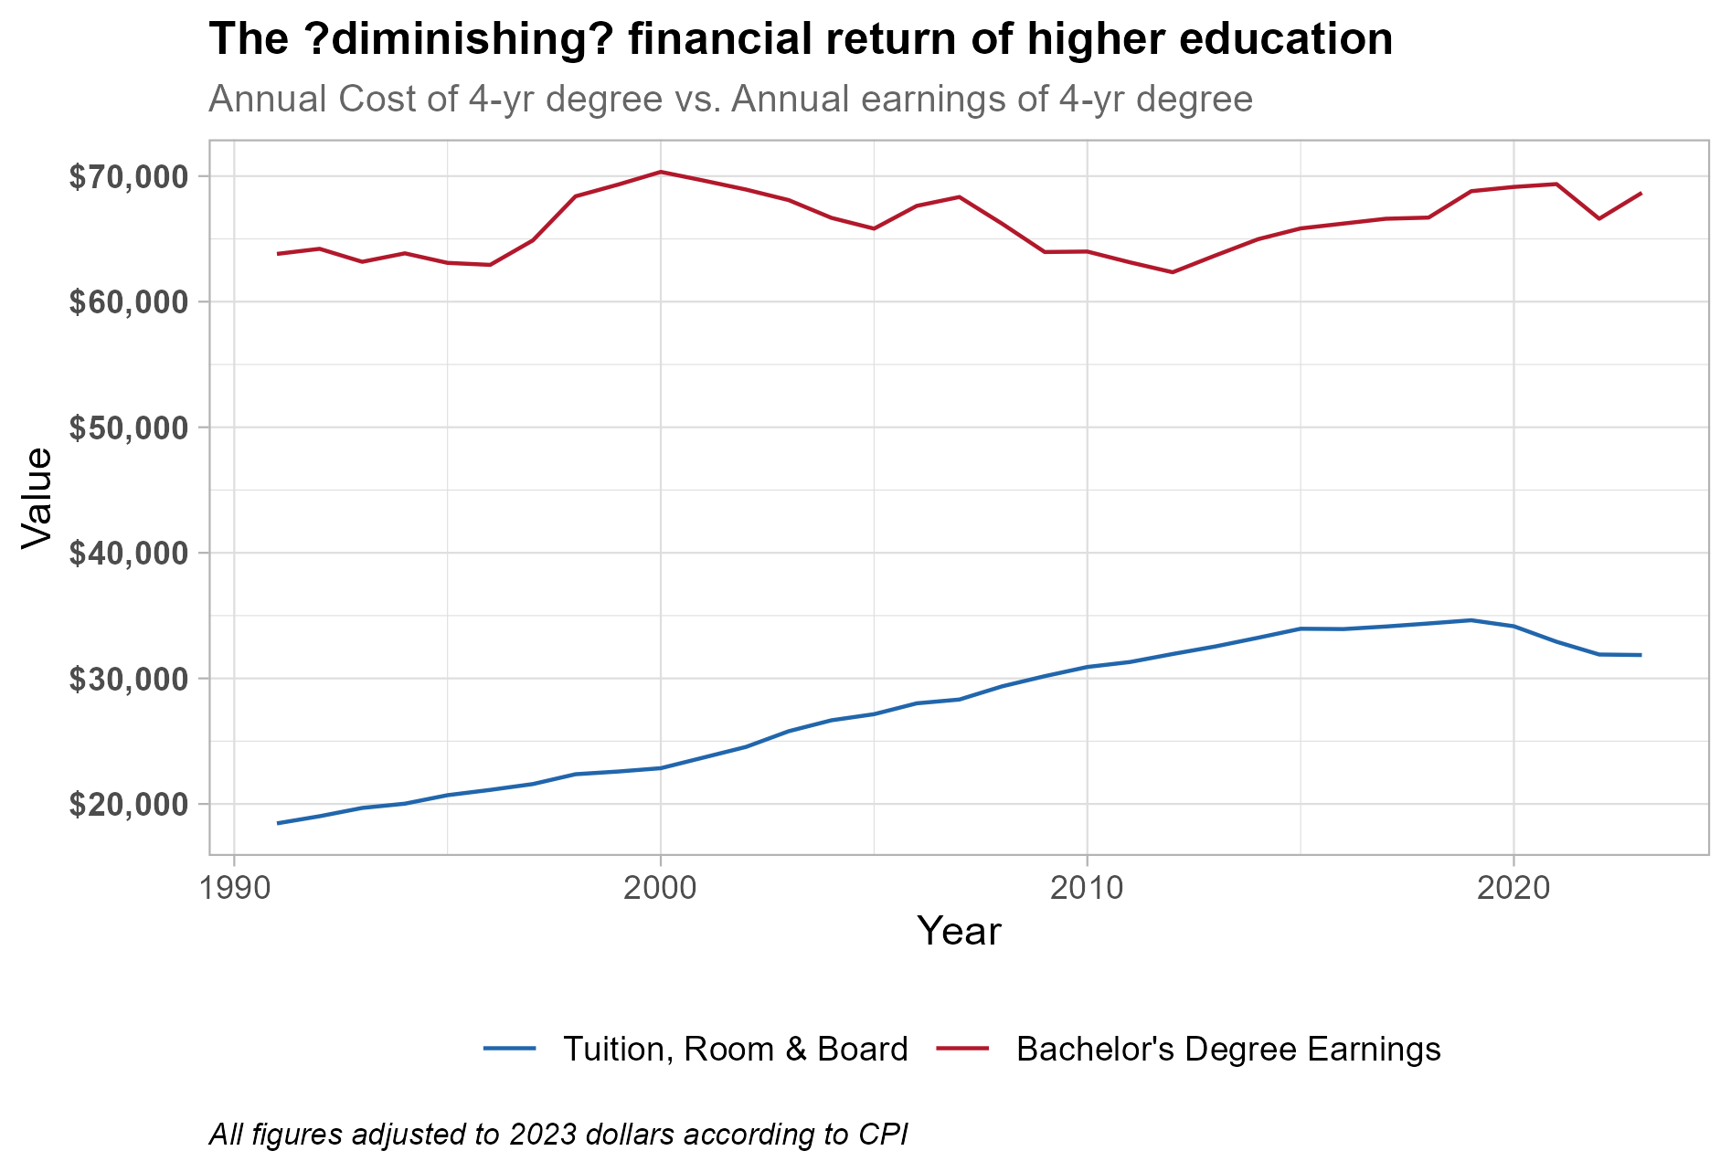
We Looked Behind the Curtain
In this case we show the ANNUAL cost of education rather than the total cost of all four years to match the ANNUAL income measure

Slide 7
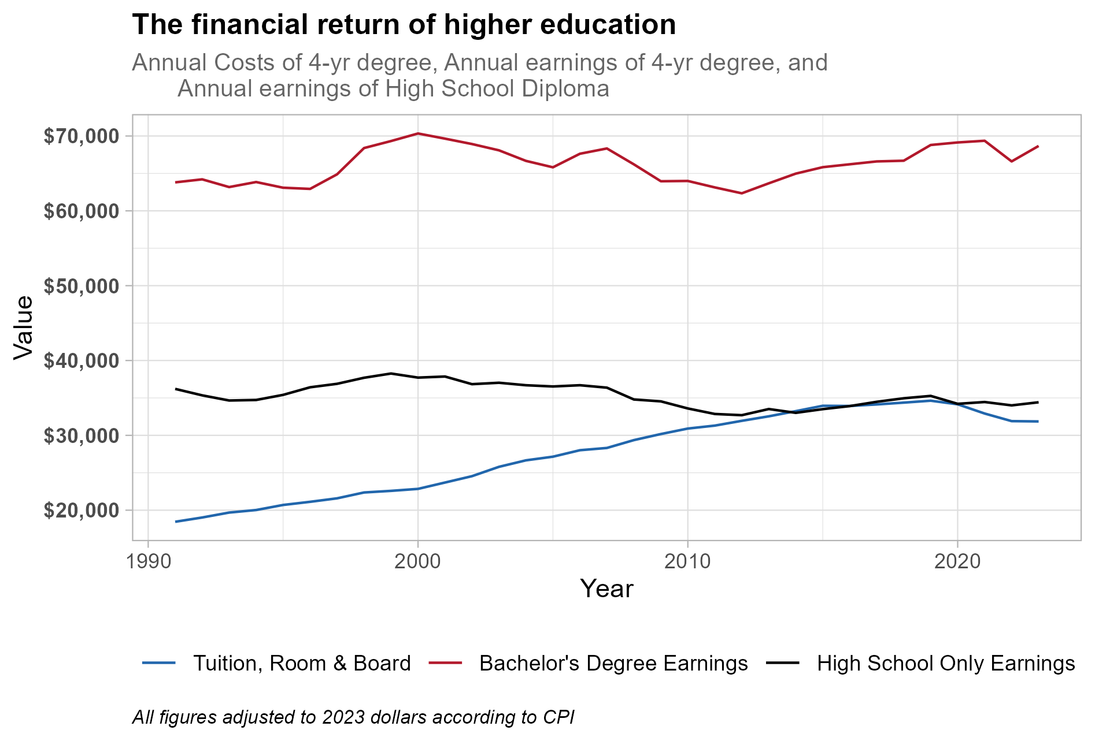
Yet Another Look
How about we add the annual earnings for people with only a High School Diploma?

Slide 8
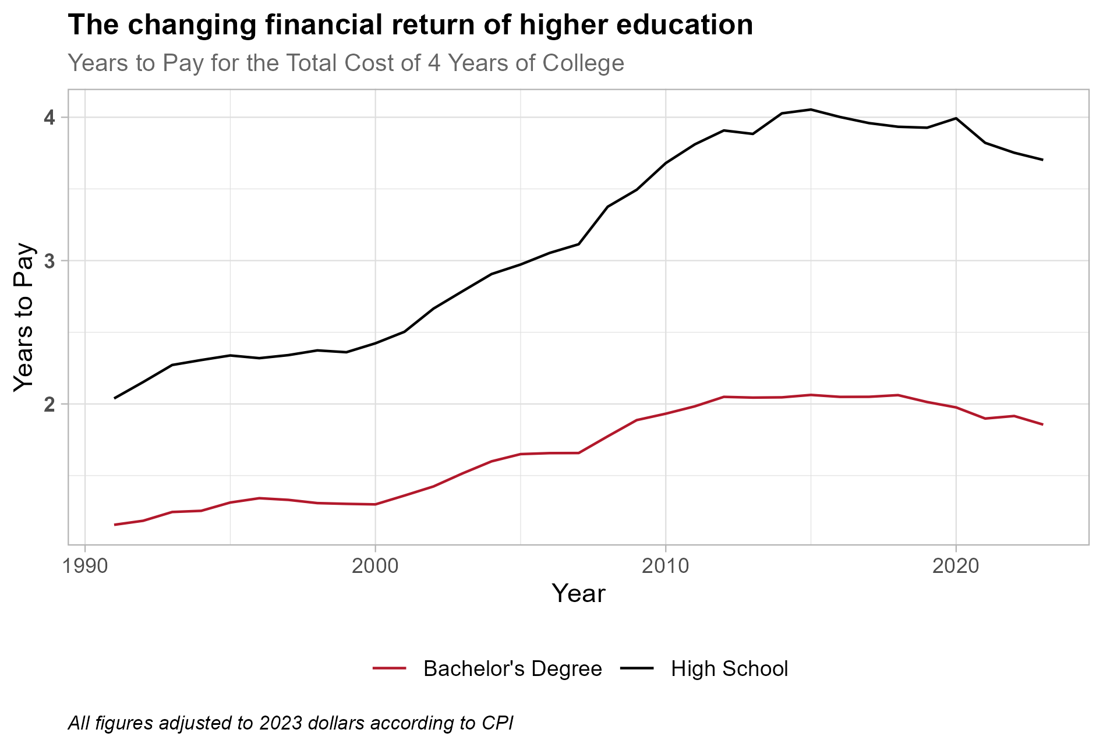
A Different Way to Tell the Story
How about we add the annual earnings for people with only a High School Diploma?

Slide 9
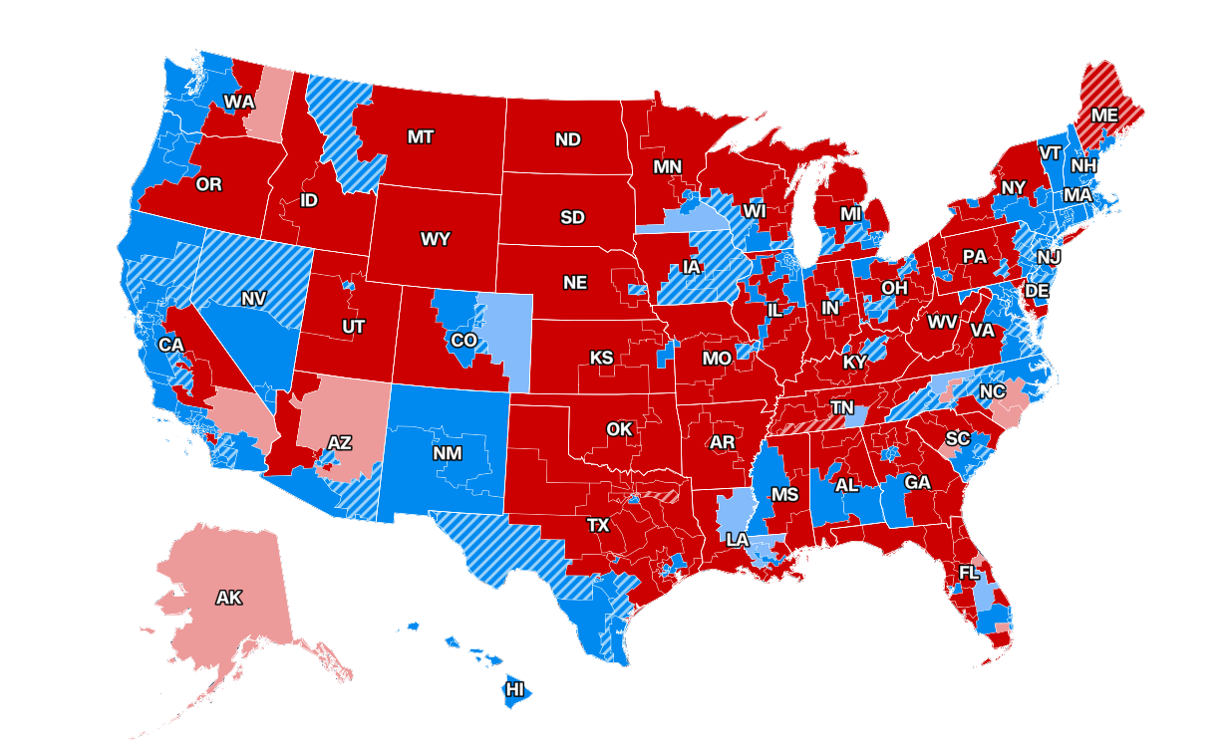
Visualization Dividing the Nation
If you follow politics (or don’t live under a rock), you have likely seen an image like this.
This is from CNN.com showing the outcome of the “Blue Wave” election just last Tuesday.
I propose that maps like this have only fed the “stolen election” and “divided nation” debate.

Slide 10
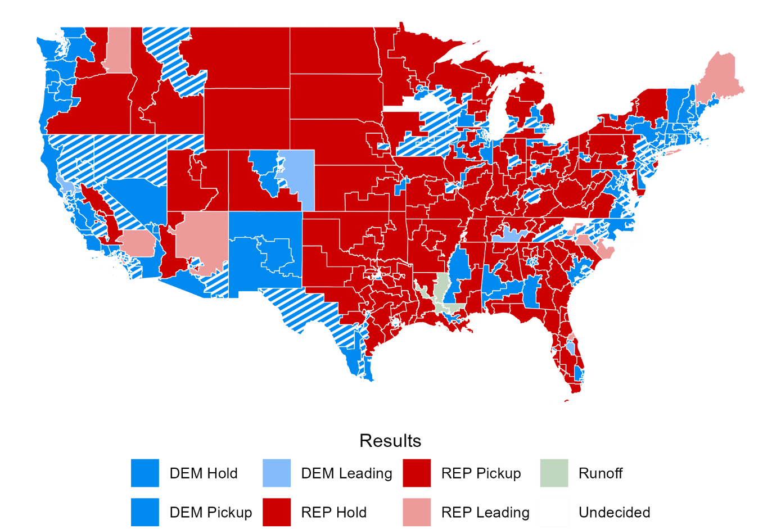
We Can Do that Too (sorta)!
The U.S. Census does not have all the redistricted maps.

Slide 11
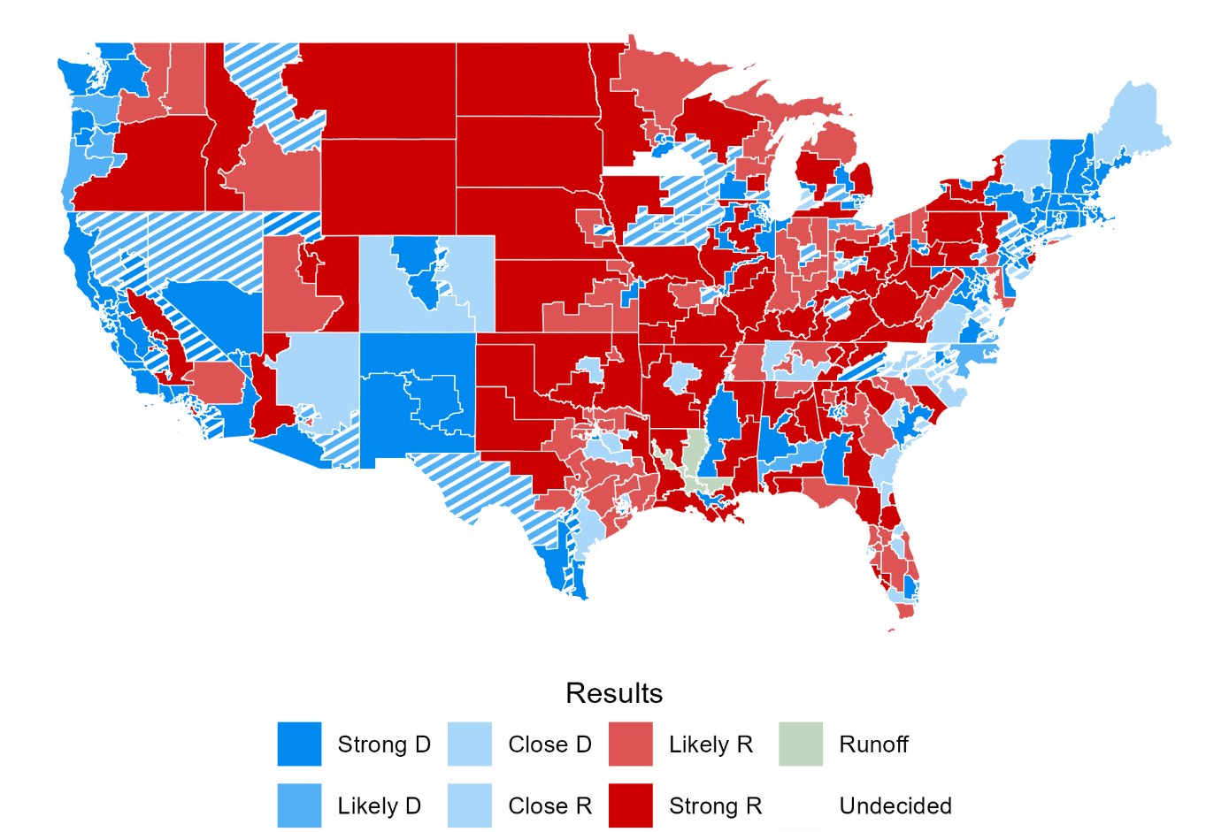
But What about This Way?
In this case, we add a “Close” measure if the race is/was within 5% difference

Slide 12
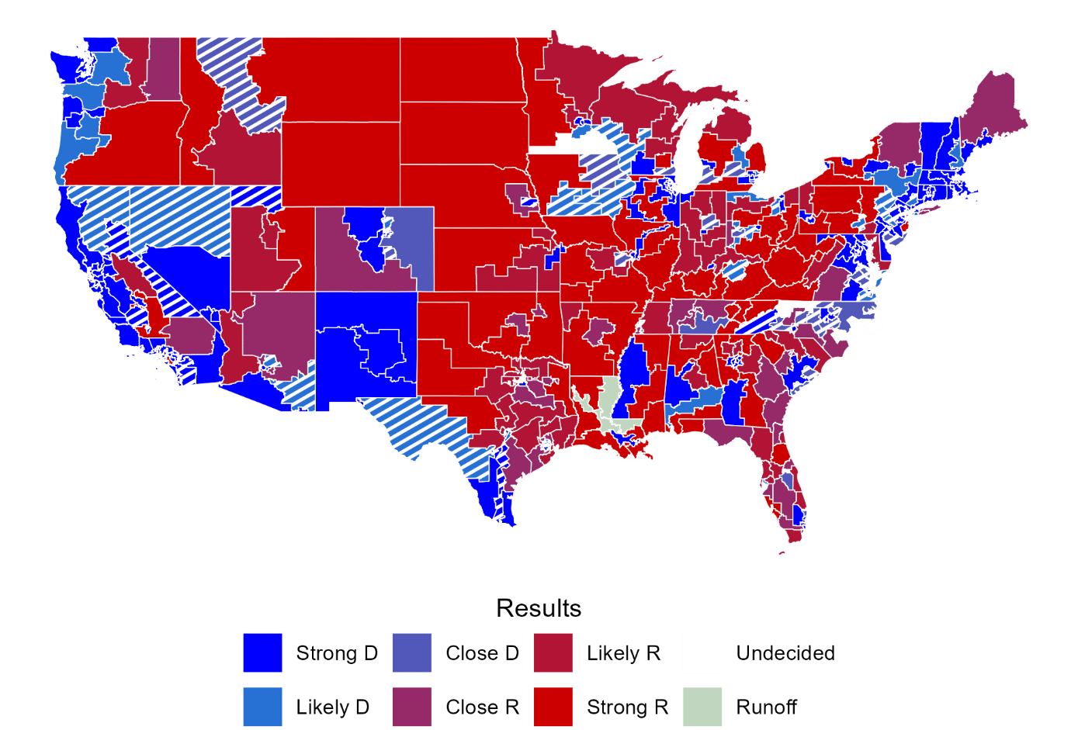
But What about This Way?
In this case, we emphasize that the “close” races are really a mix of red and blue rather than just light red or light blue. We also match the darker blue to the darker red generally used.

Slide 13
Setup
Do you have R and R-Studio Installed?
  Create a new project
  If you have/use GIT, you can clone the repo in project setup, if not, we will get it in a second.
  https://github.com/jrgroves/Rticulate
If no R, use the POSIT cloud where students can log into free and create a project so that they can use the R-Studio interface.
Go To: https://posit.cloud/
Create an account (using any email)
Choose a New R Studio Project from the upper left corner.

Slide 14
Setup
R gains its power from packages which are submitted and maintained by users.
This will install the necessary packages for our work.
  usethis is a package of utilities generally geared toward GitHub
  tirgis is a package that lets us pull down the House District Tiger Files
  sf is a package that lets us work with maps and geospatial data
  tidyverse is a great package for cleaning data and writing scripts
  tidycensus is a package that lets us use data from U.S. Census
  ggpattern is an add on to tidyverse/ggplot for non-solid fills on charts

Slide 15

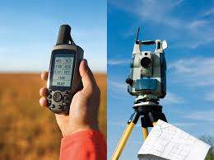
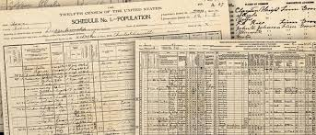
A quick detour
Getting the data you need can be the most complicated part of a project. There are several ways to accomplish this task
Original Collection. This may be going out and measuring something or collecting information or may simply be the transfer of archival data from print to digital formats.

Slide 16
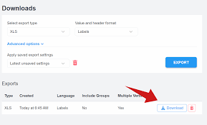
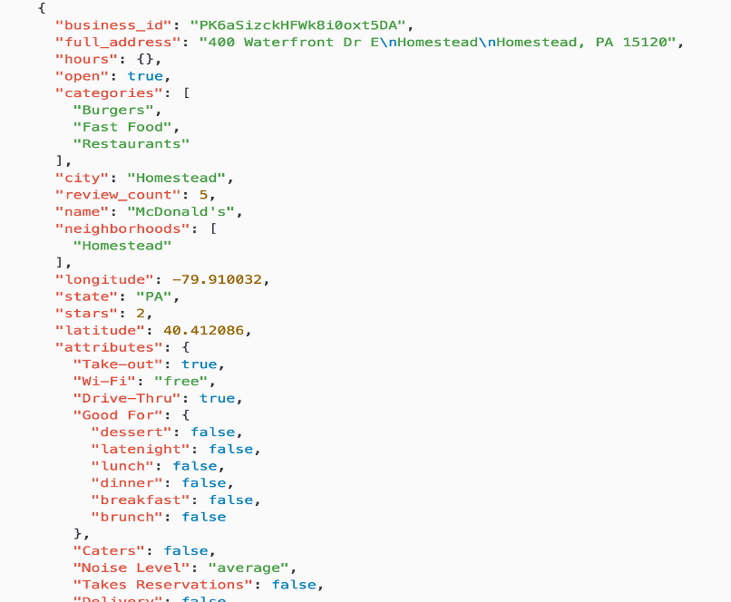
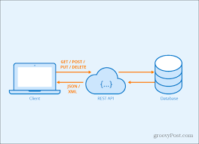
A quick detour
Downloads: This can include data from a primary source such as Redfin or Zillow for housing data, from an API source such as a government or industry database/website, or from cloud storage such as OneDrive or GitHub.

Slide 17
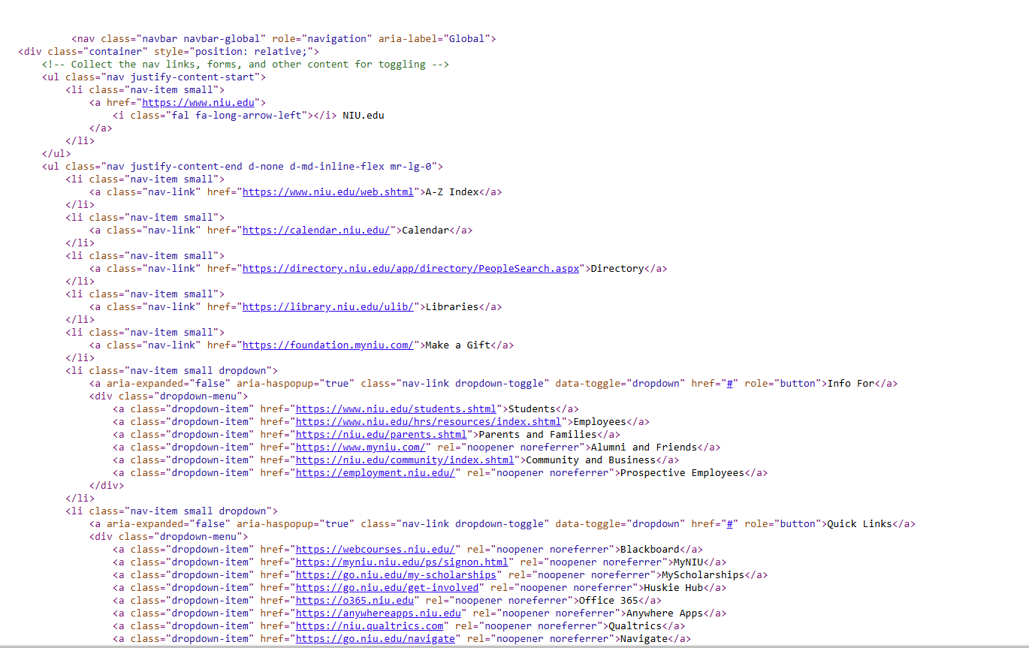
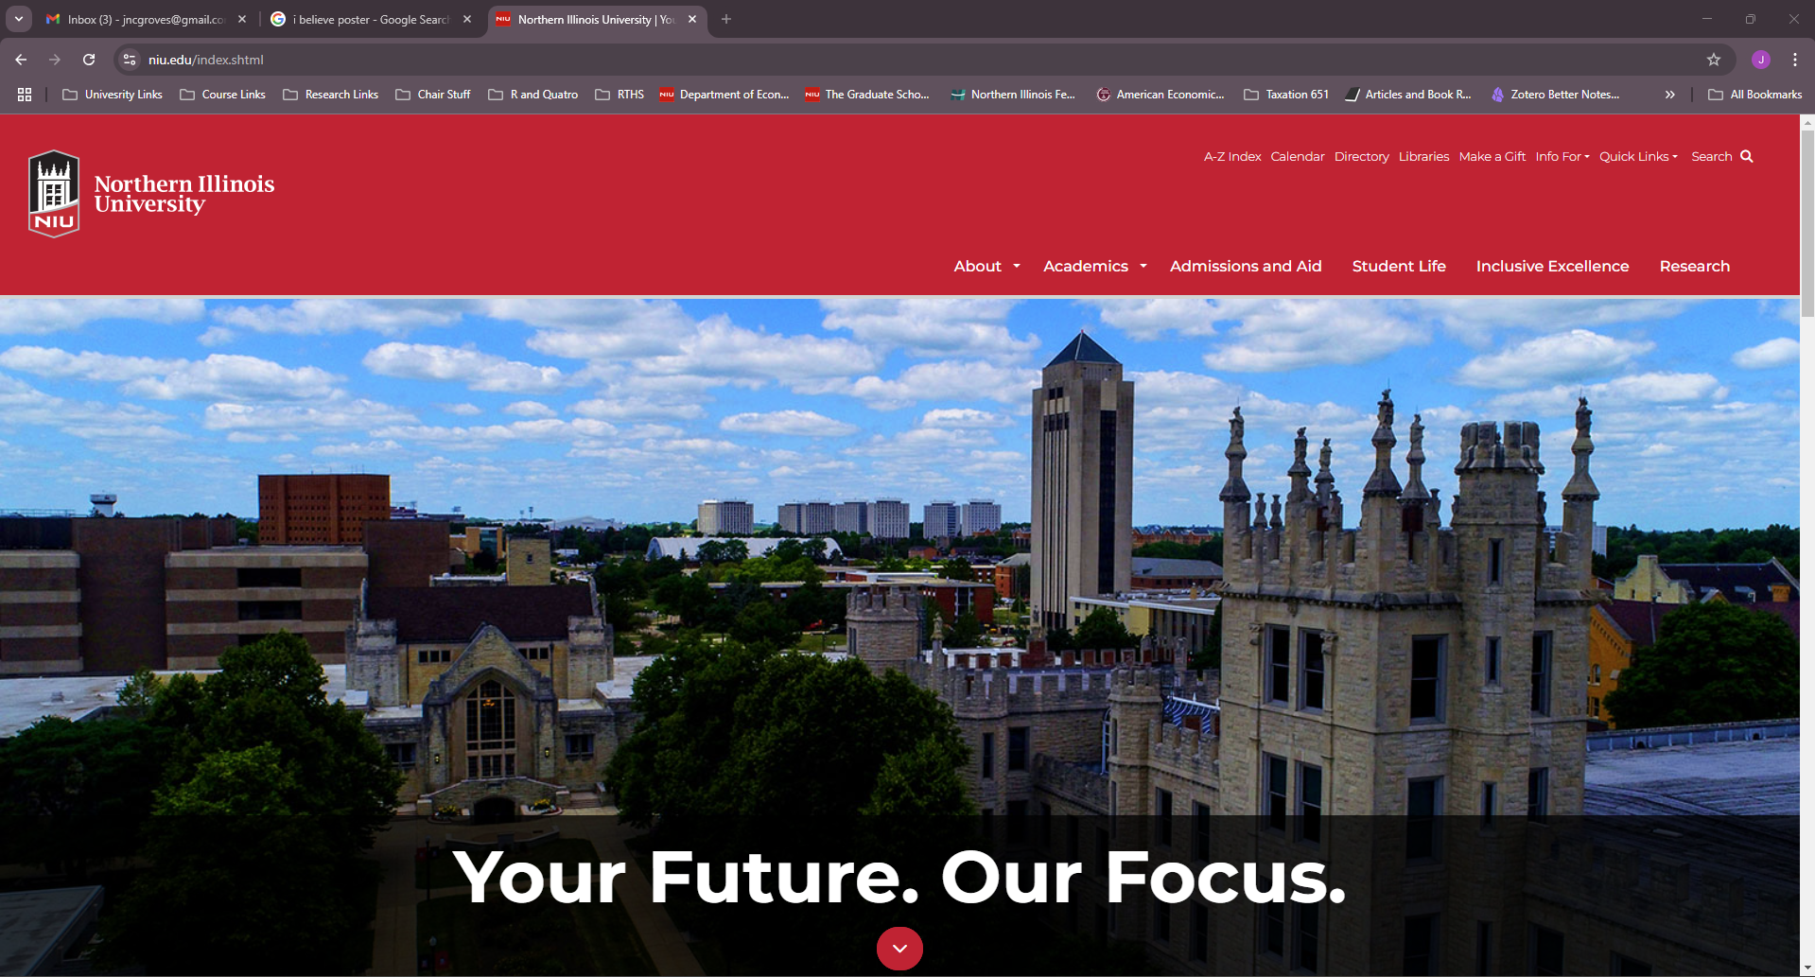
A quick detour
Scrape It: Web-scaping is the process of exploiting the fact that websites, as pretty as they might be, are still just a code written on a system according to a language.

Slide 18
Our Data
Our data comes from three key sources
Real Clear Politics: We get the vote data from the public facing widget by simple copy and paste. (https://www.realclearpolitics.com/elections/live_results/2026/house/)
USA House District Map: via an API call using the tirgis package.
FIPS Codes: Part of the tidycensus package

Slide 19
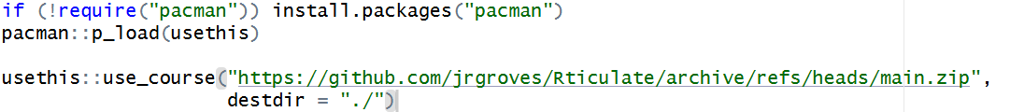
Getting Our Data
Use the use_course() command to download
  This will allow you to download the makeup of the GIT REPO and it will install into whatever your current directory is.
  This will likely open a new session of RS, but that is fine.
  You can put the zip file wherever you want on your computer by setting the destdir = “” option.

Slide 20
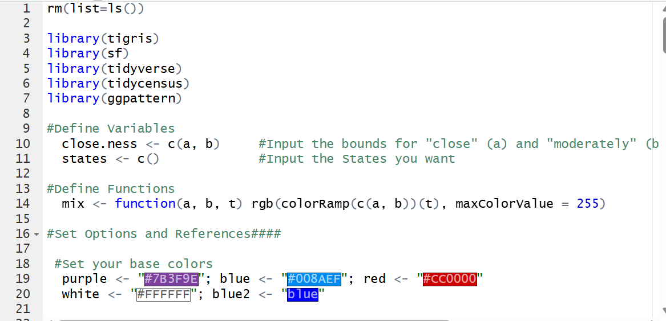
Scripting

Slide 21
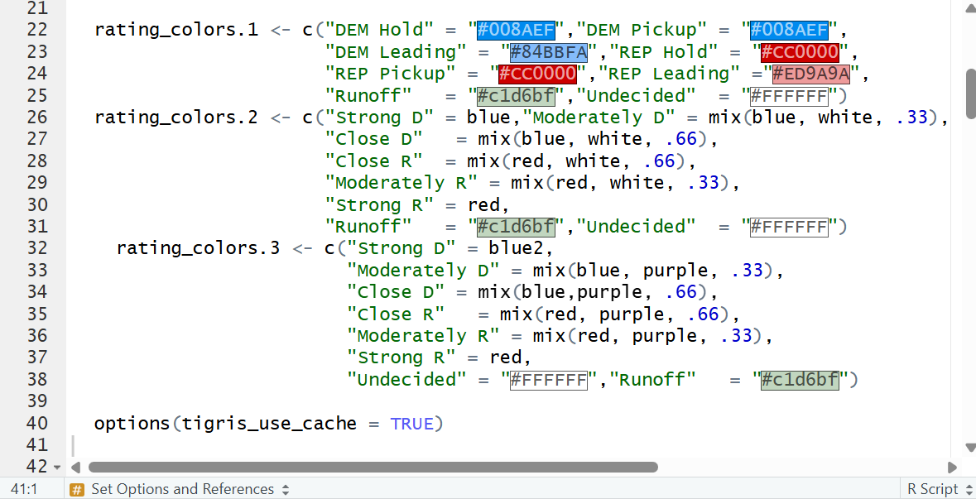
Scripting

Slide 22
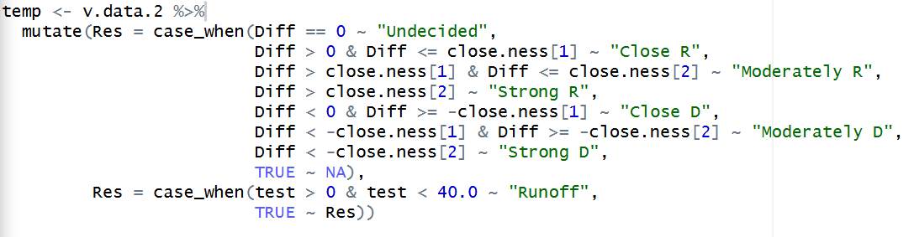
Scripting

Slide 23
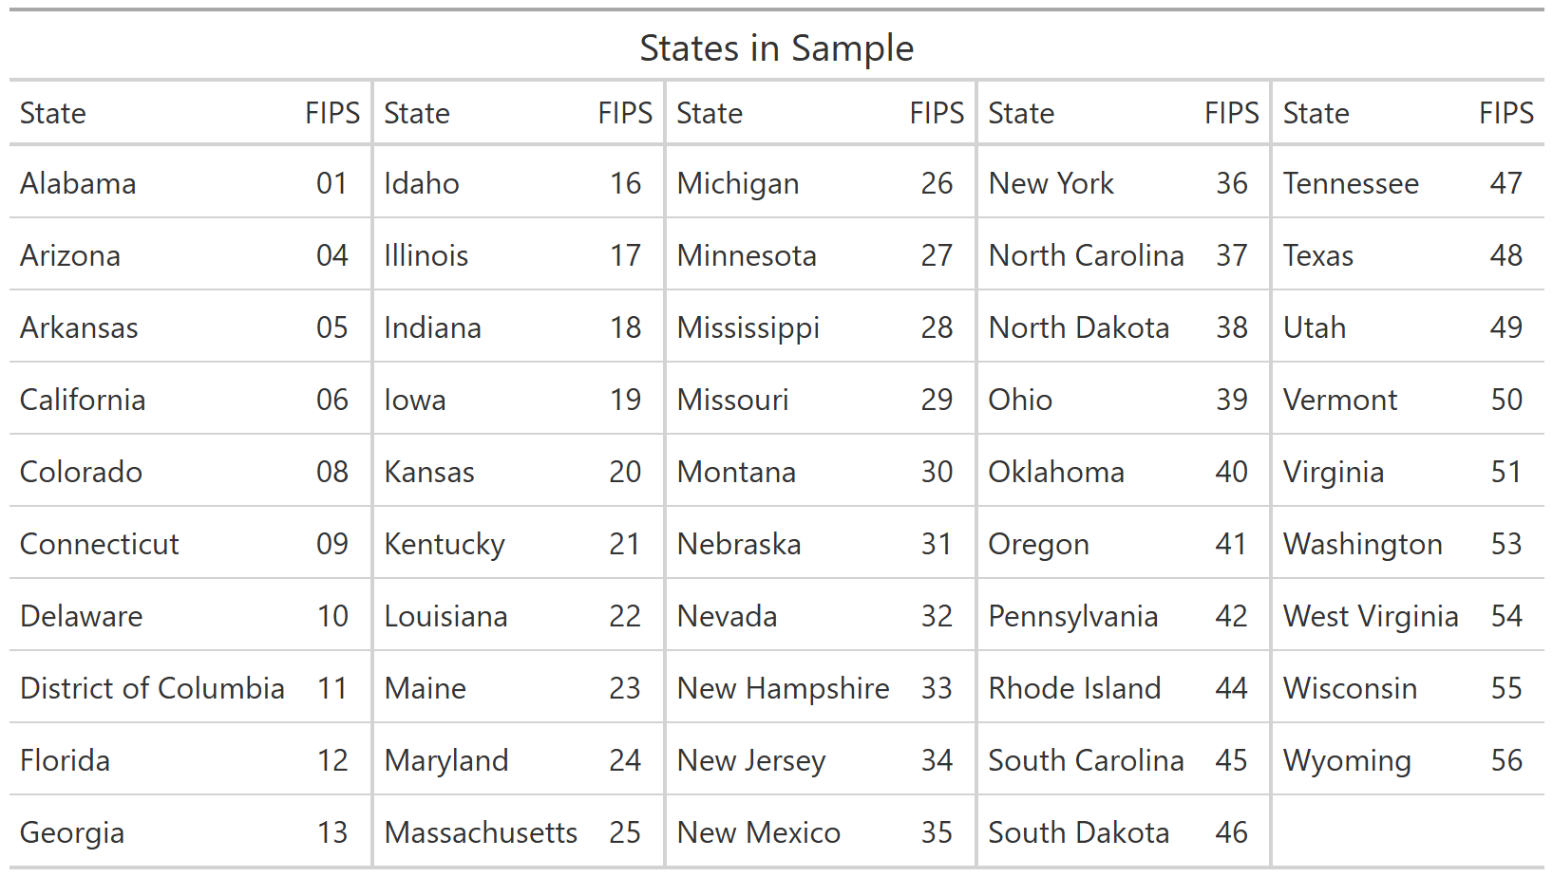
Your Settings – Your Choices
First, pick your States (be interesting, do something beside Illinois)
You will input the State FIPS code as a character where you see the line states <- c().
Assume you want Illinois and Indiana then you would have.
states <- c(“17”, “18”)

Slide 24
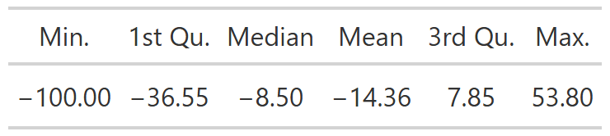
Your Settings – Your Choices
First, pick your States (be interesting, do something beside Illinois)
Secondly, pick you bounds for “close”, “moderate” and “strong”. You will put this in the line that says close.ness <- c(a, b). “a” will be the upper bound for the split between “close” and “moderate” and b will be the divider for “moderate” and “strong”.
Below are the summary states for the Diff or the difference between the Republican and Democrat votes.

Slide 25
Your Settings – Your Choices
Finally, pick your colors. Each of our main categories (Strong, Moderately, and Close) for each party, along with undecided races and runoffs (if you pick LA) need a color assigned.
In our example, we first assign some base colors object names.
Then we use a function we created (with help) called mix to “mix” two colors using a base R function

Slide 26
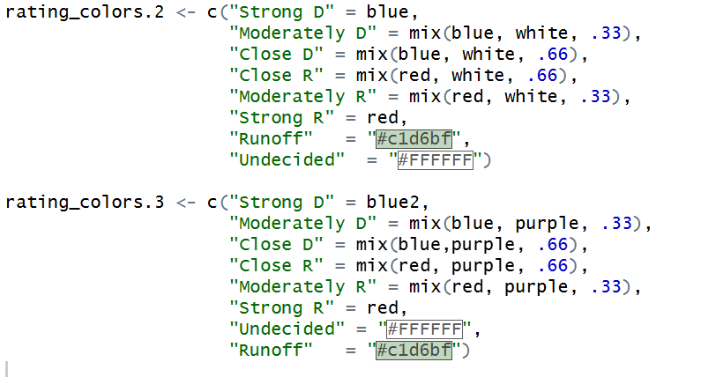
Your Settings – Your Choices
In the colors.2 set we mix the base (blue/red) with white and in colors.3 we use purple as the mix.
You can use whatever colors you want; but make sure they fit your story.

Slide 27
Your Settings – Your Choices
You have now coded your first R data visualization script. Go to the top-right of the editor window and click on SOURCE.
Once it is finished, you should see your image in the lower-right window. Click on Zoom and then make it full screen.
Do your graphs tell the same or different stories based on the colors you used?

Slide 28
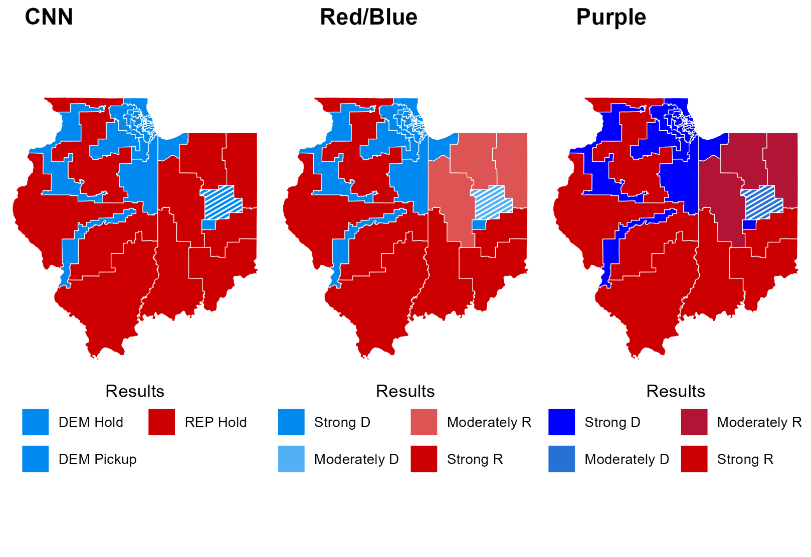
Your Settings – Your Choices
I used Illinois and Indiana and set the bounds at 3% for close and 10% for moderately.
Notice that Indiana is not quite as “RED” as people seem to think in terms of the northern part.

